Slide 1
Compare Chinese and Western Culture’s Privacy through Social Media Privacy Policies
韩瑛
张清泉
赵书彬

Slide 2
CONTENT
01
ABSTRACT & Concept of Privacy
02
Privacy Policy of Applications in Different Culture
03
Principle of Difference Appearing
04
Conclusion

Slide 3
01
Concept of Privacy
PART ONE
Differences between concepts of two sides

Slide 4

1. Concept of Privacy
Privacy Influences Communication
Different Ideas to Privacy
Internet Privacy
We will consider Chinese and western culture’s privacy attitudes through comparing privacy policies of social media in China and the US. (After all, most social media applications are from these countries.)

Slide 5
02
Privacy Policy of Applications in Different Culture
PART TWO

Slide 6

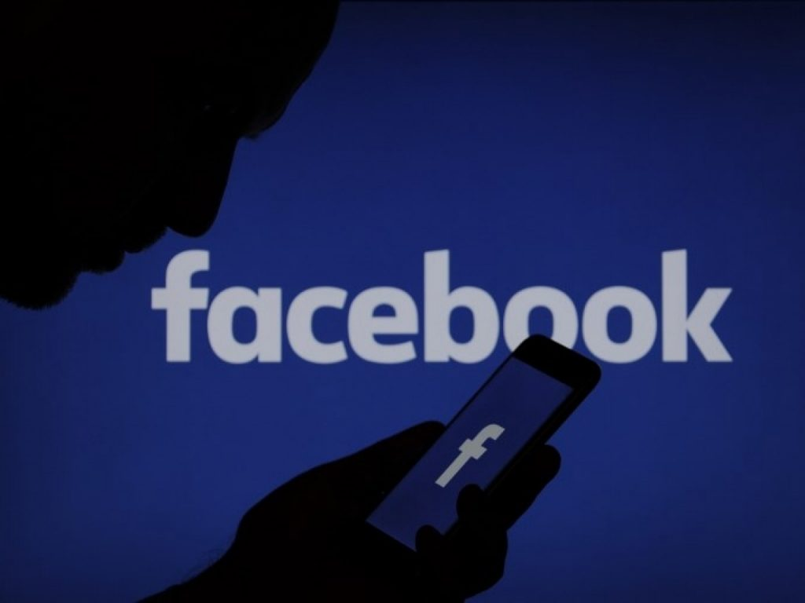
2. Privacy Policy of Applications in Different Culture
Clear or Not
Differences
Technical
Detail
Humanized Design

Slide 7
03
Principle of Difference Appearing
PART THREE
According to spatial zones from Edward Hall (1996), and Hofstede’s cultural dimensions.

Slide 8
3. Principle of Difference Appearing
High level acquirement of personal privacy in western culture
Keep spatial zone of individual
Compared with it in China

Slide 9
3. Principle of Difference Appearing
Using power distance theory and individualism and collectivism theory.
We are in a collectivistic culture so we can bear more about privacy. (may be related to high power distance)
Compared with the western ones.

Slide 10
04
Conclusion
PART FOUR

Slide 11

4. Conclusion
In conclusion, all of these differences can be concluded into cultural difference from root, according to the previous analysis, which can be ascribed to the characteristics of intercultural communication which extends on Internet.
In China
More information but less information safety->Collectivism
In the West
Keep their information protected
->Individualism

Slide 12
韩瑛
Thanks for Listening
张清泉
赵书彬

